Slide 1
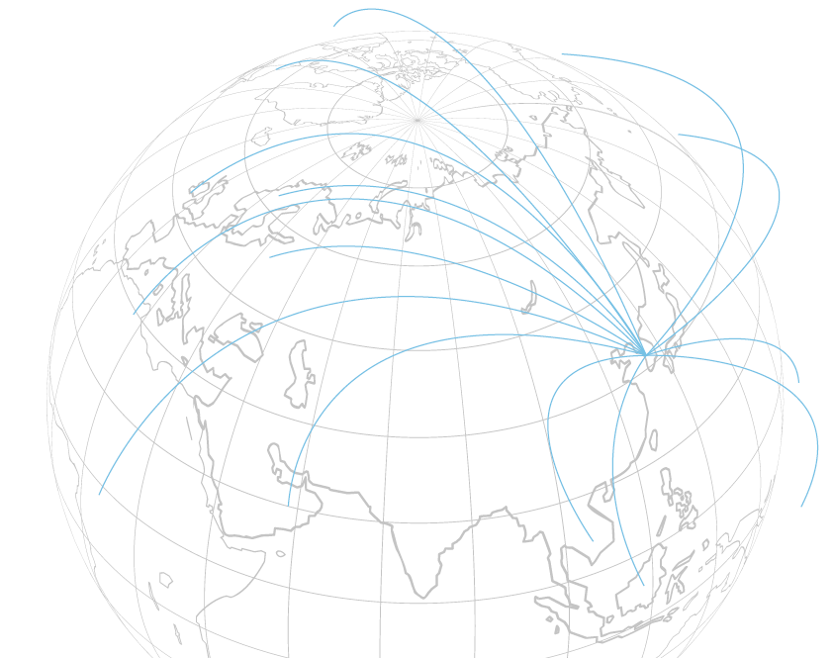


중국 SDV 표준
표준 내용과 관련 동향
Mobility Platform Research Center
Intelligent Information Research Division
AI Convergence R&D Laboratory
Korea Electronics Technology Institute
2025년08월
박부식 센터장
(pusik.park@keti.re.kr)

Slide 2

소제목
소제목의 부제목

Slide 3
제목
Notes:
This slide shows the C-ITS specification of Korea and Europe.
These old texts mean the solution KETI already has.
KETI is supporting several companies for their C-ITS business.
When they want to expand their business to Europe, KETI can support their business for example, inter-operability test in AstaZero.
(생략)
As I briefly mentioned earlier, for C-ITS, Korea is following the American approach for the Day 1.
However, in the Day 2 phase, it’s possible that everyone will unify under the 5G-V2X.
Fortunately, my center has C-ITS protocol software stack solution essentials for 5G-V2X and I’ll be able to assist small and medium-sized enterprises in their business efforts for C-ITS.

